Slide 1

Negative and Harmful Speech Detection
Data Mining
For Business Application
Group Members:
1. Siddharth Kaushik - 2024dss1019
2. Saif Saleem - 2024dss1015
3. Ujjawal Singh. - 2024dss1023
4. Ayush Kumar. - 2024dss1004
https://github.com/siddharth404/Negative-and-Harmful-Comment-Detection
https://negative-and-harmful-comment-detection.streamlit.app/

Slide 2
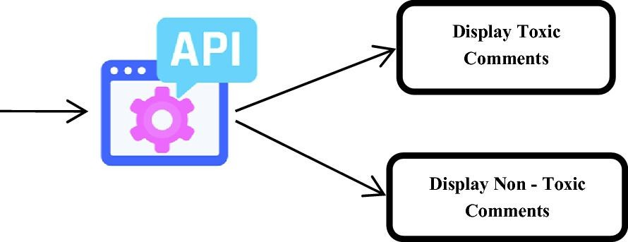
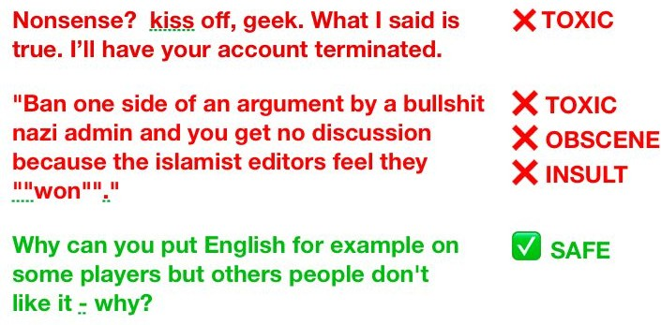
Overview
Detection and Flagging of comments containing text which may incite violence, spread hate and induce negativity.

Slide 3
Introduction
The project Negatice and Harmful Comment Detection aims at:
Removing any textual material containing hate or toxicity.
Online bullying has become a serious issue in recent years.
The threat of abuse and harassment online means that many people stop expressing themselves.
Toxic comments spread negativity, racial harassment and depression
Removing hate speech makes easy for everyone to express their opinions freely over the internet.

Slide 4
Motivation & Applications
Social networking: Message or tweet can be reported to the support team.
Online meetings / webinars: Message can be hidden from attendees and shown only to the moderators.
Chatbot training: The model can give large negative feedback for any insulting reply towards the user.
Threatening messages: Directly reported to concerned authorities for immediate actions.

Slide 5
📚 Application of Data Mining Concepts
- ✅ Data Preprocessing:
- Handling nulls, cleaning, lowercasing, stemming/lemmatization
- Vectorization using CountVectorizer and TF-IDF
- ✅ Feature Engineering:
- Extracted features: length of comment, unique word %, correlation of labels
- ✅ Model Building:
- Used Binary Relevance (BR) and Classifier Chains (CC)
- Applied models: Logistic Regression, SVM, XGBoost, LSTM
- ✅ Evaluation:
- Multi-label metrics: ROC AUC, label-wise accuracy
- Visual comparison of models and AUC scores
- ✅ Deployment:
- Integrated models into a real-time dashboard using Streamlit
- Enabled user interaction, visual insights, and OCR prediction

Slide 6
Structure of Presentation

Slide 7



Conclusion and Scope of Improvement
Description of the Problem Statement and Challenges
Preprocessing of data into machine readable format
Problem
Visualisation
Preprocessing
Training
Conclusion
Cleaning and Visualisation of the dataset
Training the model using various methods

Slide 8
Problem Description

Slide 9
Problem Description
Statement
Given any text or paragraph containing a few lines in natural language, the objective is to classify it as belonging to one or more of the following categories: clean, obscene, threatening, insulting, toxic, severely toxic and identity hate.
Clean
OUTPUT
Obscene
Threatening
Text / Paragraph (natural language)
INPUT
ONE OR MORE OF THESE CLASSES
Model
Insulting
Toxic
Severely Toxic
Identity Hate

Slide 10
Problem Description
Multi-class classification problem
Multi-label classification problem
Seven different classes: Clean, obscene, threatening,
insulting, toxic, severely toxic, identity hate.
Any text or paragraph can be abusive in multiple ways: it can be both threatening & insulting to someone
Model will output the probability of text to belong to each category.
Based on certain threshold (which can be tuned as hyperparameter), the text can be classified to be belonging to a category / set of categories.

Slide 11
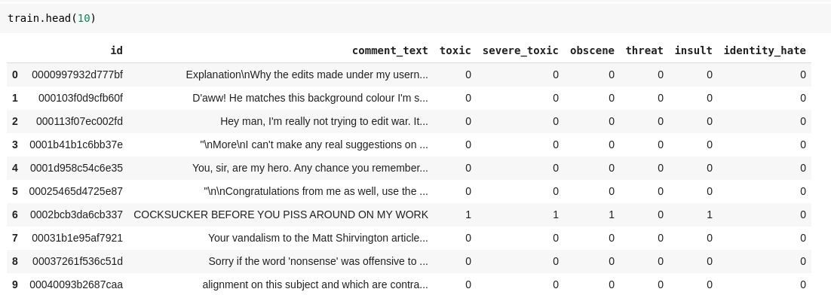

Dataset
Dataset is made publicly available by Conversation AI.

Slide 12
Labels
The dataset has been labeled on a crowdsourced annotation platform.
Different users may have different opinions about a comment (judgement bias).
Some offensive ‘ASCII arts’ which may or may not be labelled as toxic by users depending on how it was rendered.
Some extremely long comments got labelled to toxic without any significant reason.
“Give us your address and we'll come and kill you” : Not marked as toxic!

Slide 13
Challenges
Noisy Data: Real world dataset from Internet users. Full of slangs, contractions, non-english or meaningless words and spams.
Unbalanced Dataset: Large number of comments are clean. Unclean samples are relatively rare and with six classes of toxicity problem is further aggravated.
Computational Capability: Natural Language Processing models like RNN requires huge processing powers and powerful GPUs for efficient training.
Memory Issues: More than 1 lakh training samples - difficult to store and process in internal memory at a time.

Slide 14
Solution Approach
Dataset
Conversational AI
Data Cleaning & Visualization
Get qualitative high-level insights into the data
Data Pre-processing
Remove punctuations, stop words, stemming, etc.
Binary Relevance
Classifier Chains
Support Vector Machines
Training the model
XGBoost
Extremely Random Trees
Data Post-processing
Reason out the possible source of errors
Recurrent Neural Networks
Transfer Learning

Slide 15
Data Cleaning & Visualisation

Slide 16
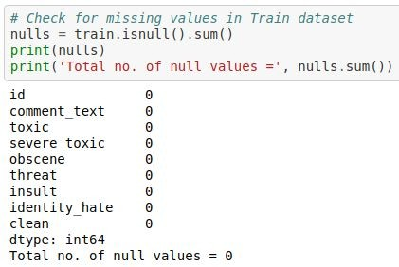
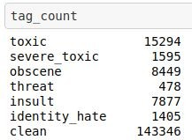

Data Cleaning & Visualization
Checking for missing or null values.
Adding extra column for ‘clean’ comments.

Slide 17
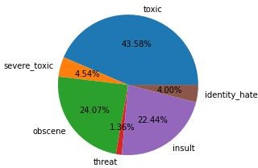
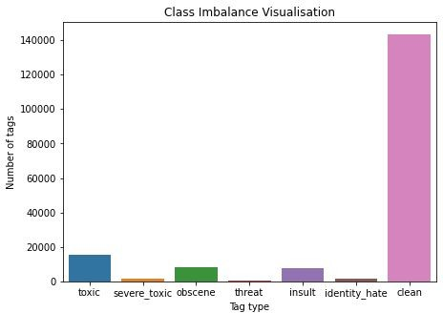
Data Cleaning & Visualization
Class Imbalance: The toxicity is not spread evenly across all the classes. Out of all the hate tags, ‘toxic’ tags are 43.58%, whereas ‘threat’ tags are 1.36%.
Clean comments are ~140k out of the ~160k total comments.

Slide 18
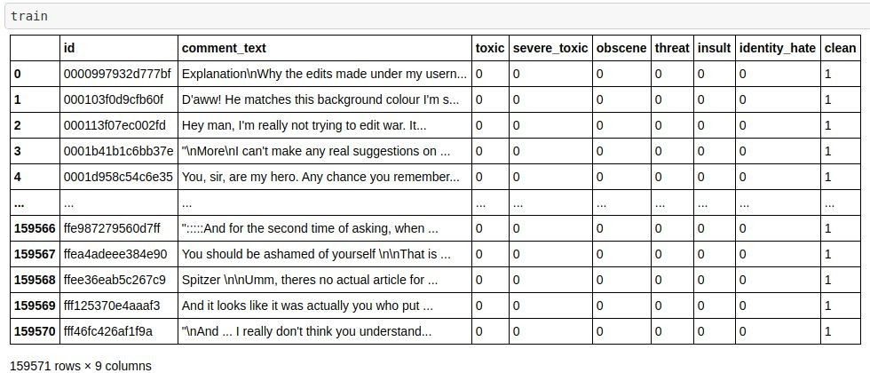
Data Cleaning & Visualization

Slide 19
Data Cleaning & Visualization
Comments obtained are from random users on internet
Dataset is noisy. No fixed standard of writing across all the comments
Dataset must be cleaned before further steps to obtain meaningful results
Remove non alphanumeric characters (ip addresses, time, date) and punctuations.
Convert everything to lower case letters.
Detect and remove extremely long words (may cause overfitting), non english and meaningless words.

Slide 20
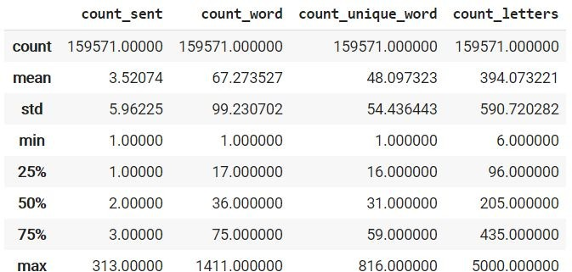
Data Cleaning & Visualization
How long are comments?

Slide 21
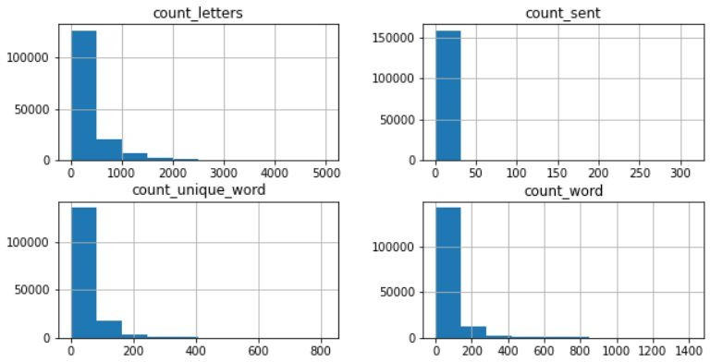
Data Cleaning & Visualization
How long are comments?

Slide 22
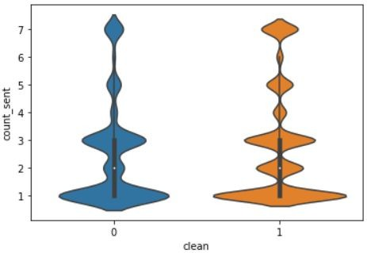
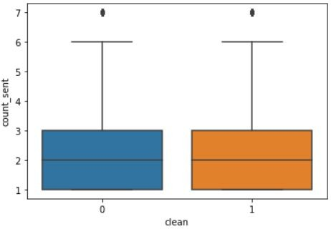
Data Cleaning & Visualization
Are longer comments more toxic?
Violin Plot
Box Plot
No significant correlation between length & toxicity is observed.

Slide 23
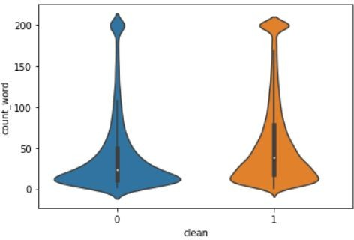
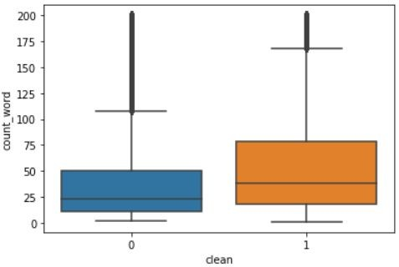
Data Cleaning & Visualization
Are longer comments more toxic?
Violin Plot
Box Plot
Slight correlation is observed. Lesser words increase the chances of toxicity.

Slide 24
Data Cleaning & Visualization
Are spammers more toxic?
A cursory look at comments reveal many comments which look like spam.
EPIC FAIL! | EPIC FAIL | EPIC FAIL! | EPIC FAIL EPIC FAIL! ...
EPIC FAIL! | EPIC FAIL | EPIC FAIL! | EPIC FAIL EPIC FAIL! ...
How to classify spammers?
Though spam detection is a wide area of research in its own we can use a very simple approach which suffice for our application.
Take comments with lot of repeated words (i.e. very less % of unique words).

Slide 25
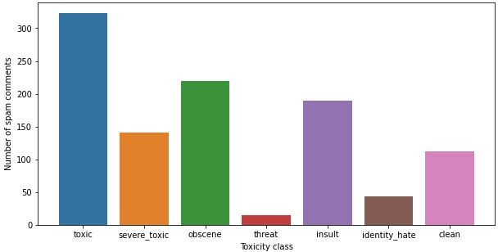
Data Cleaning & Visualization
Are spammers more toxic?
Bar Plot
Lesser percentage of unique words increases the chances of toxicity.

Slide 26
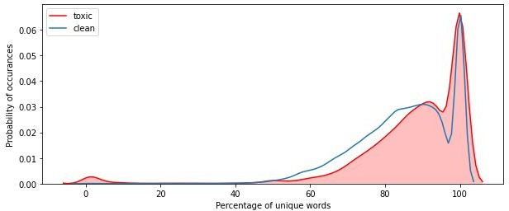
Data Cleaning & Visualization
Are spammers more toxic?
KDE Plot
More percentage of unique words DOES NOT decrease the chances of toxicity.

Slide 27
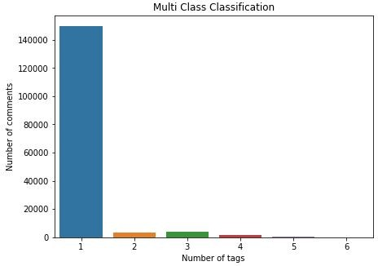
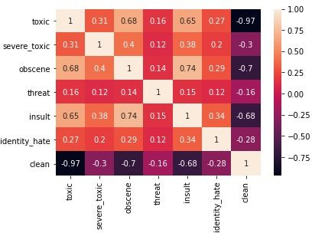
Data Cleaning & Visualization
Multi-class classification: A lot of comments have only one tag, yet there do exist some comment having 5 or 6 hate tags.
Heatmap of the correlation between the tags.

Slide 28
Data Cleaning & Visualization
[18:00 3/7/2010]: Hey man!!, I'm
really not trying to edit war. It's just that this guy is constantly removing relevant information and talking to me through edits instead of my talk page. He seems to care more about the formatting than the actual info. (@172.16.254.1)
hey man i m really not trying to edit war it s just that this guy is constantly removing relevant information and talking to me through edits instead of my talk page he seems to care more about the formatting than the actual info
DATA CLEANING
COMMENT
CLEANED COMMENT

Slide 29
Data Preprocessing

Slide 30

Data Preprocessing
Cleaned Data
out, what, most, any, off,
too, have, more, or, the,
ours, both, whom, and, of,
aren, her, does, from, if, not,
own, this, it, a, it's, hers,
why, who, now, been, me, ...
STOP WORDS
Data Preprocessing
argue
argued
argu
Machine Readable Format
STEMMING
argues
arguing

Slide 31
Data Preprocessing
Conversion of cleaned data to machine readable format.
Stop Words
Commonly used words which don’t add any meaning to the text.
E.g.: ‘is’, ‘are’, ‘this’, ‘at’, etc.
Removed the stop words using NLTK stopwords corpus.

Slide 32
Data Preprocessing
Stemming
Transforming a word into its base stem, i.e., a set of characters to construct a word and its derivatives.
Helps in reducing the vocabulary of words, which convey the same meaning.
E.g. ‘argue’, ‘argued’, ‘argues’ and ‘arguing’ are reduced to the base stem ‘argu’.
Used NLTK implementation of the Porter Stemming Algorithm - it contains a set of rules to transform a word into its base stem.

Slide 33
Data Preprocessing
hey man i m really not trying to edit war it s just that this guy is constantly removing relevant information and talking to me through edits instead of my talk page he seems to care more about the formatting than the actual info
hey man realli tri edit war guy constantli remov relev inform talk edit instead talk page seem care format actual info
DATA PREPROCESSING
CLEANED COMMENT
COMMENT IN MACHINE READABLE FORM

Slide 34
Training Models

Slide 35
Results and Comparison
Model | Mean AUC_ROC Score
Support Vector Machines (Binary Relevance) | 0.66
Support Vector Machines (Classifier Chains) | 0.67
Logistic Regression (Binary Relevance) | 0.73
Logistic Regression (Classifier Chains) | 0.76
Extra Trees | 0.93
XGBoost | 0.96
LSTM without pretrained embeddings | 0.97
LSTM with FastText embedding | 0.96
LSTM with Glove embedding | 0.88
LSTM with Word2Vec embedding | 0.85

Slide 36
🖥️ Final Deliverable: Interactive Web App
- Real-time text classification via Streamlit
- Screenshot upload with text extraction using EasyOCR
- Advanced data visualizations:
- Correlation heatmap
- Spam percentage vs toxicity
- Comment length vs toxicity
- Model performance dashboard with ROC AUC metrics
- Fully compatible with Streamlit Cloud deployment

Slide 37
⚙️ System Architecture
1. Text or Screenshot Input
2. Preprocessing (Cleaning, Lowercase, Stopword Removal)
3. Feature Extraction via TF-IDF Vectorizer
4. Classification using MultiOutput Logistic Regression
5. Output: Toxic, Severe Toxic, Obscene, Threat, Insult, Identity Hate

Slide 38
🔍 Advanced Features
- EasyOCR for image-to-text detection (OCR)
- Custom class-weighted Logistic Regression for handling imbalance
- Streamlit-based web interface
- Visual exploration of toxicity patterns
- Designed for easy extension with BERT/Transformer models

Slide 39
📊 Sample Predictions
- “You are such an idiot.” ➝ Detected: Insult, Toxic
- “This is terrible, I will hurt you.” ➝ Detected: Threat, Toxic
- OCR: Uploaded image containing hate ➝ Auto-classified using EasyOCR + ML model

Slide 40
Conclusion and Further Works
Classical Models like SVM and Logistic Regression fail to achieve high AUC_ROC score.
Classifier Chain method has a slight edge over Binary Relevance.
Tree based ensembling methods and Recurrent Neural networks can achieve a very high AUC_ROC score.
Transfer learning reduces the execution time but does not help with performance.
Further Improvements can be achieved by experimenting with complicated neural networks and use of state of the art Transformers.

Slide 41
✅ Final Outcomes & Future Scope
✔ Built and deployed a fully functional hate speech detection app
✔ Integrated OCR for image-based comment analysis
✔ Designed interpretable visual dashboards and label insights
🔜 Next: Add multilingual support, Transformer-based classification, and real-time social media feeds

Slide 42
Thank You.

